Slide 1

Making a Magnificent Movie
Seth Galluzzi, Marin Lolic and Ryan Viti
DS 6040
August 10, 2022

Slide 2
Aim
Rationale
The aim of this exploration is to determine how different movie characteristics are associated with the Tomatometer.
We will accomplish our aim by exploring data visualizations, analyzing results, and using Bayesian statistics to create a logistic regression model that can accurately predict the value of the Tomatometer. Upon completion, we will have a better understanding of how movies are scored, and what makes a good movie.

Slide 3
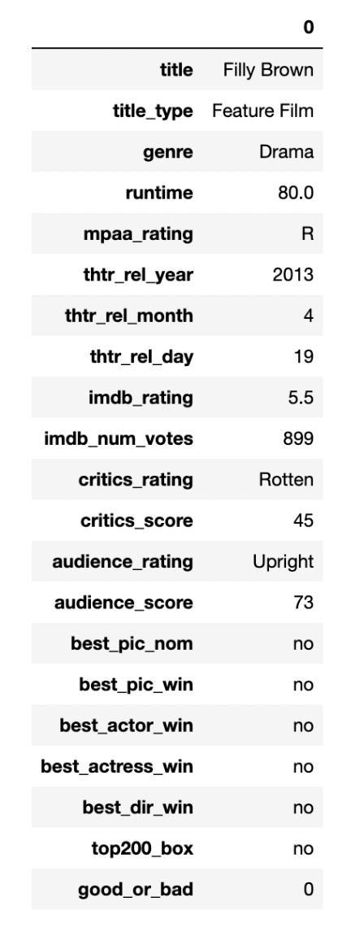
The Data
The data used was obtained from Duke University.
651 random samples of movies produced before 2016.
Minor data cleaning performed
No missing values or imputations
Two categorical variables for response
critics_rating (3 categories)
good_or_bad (2 categories - binned critics_rating)

Slide 4
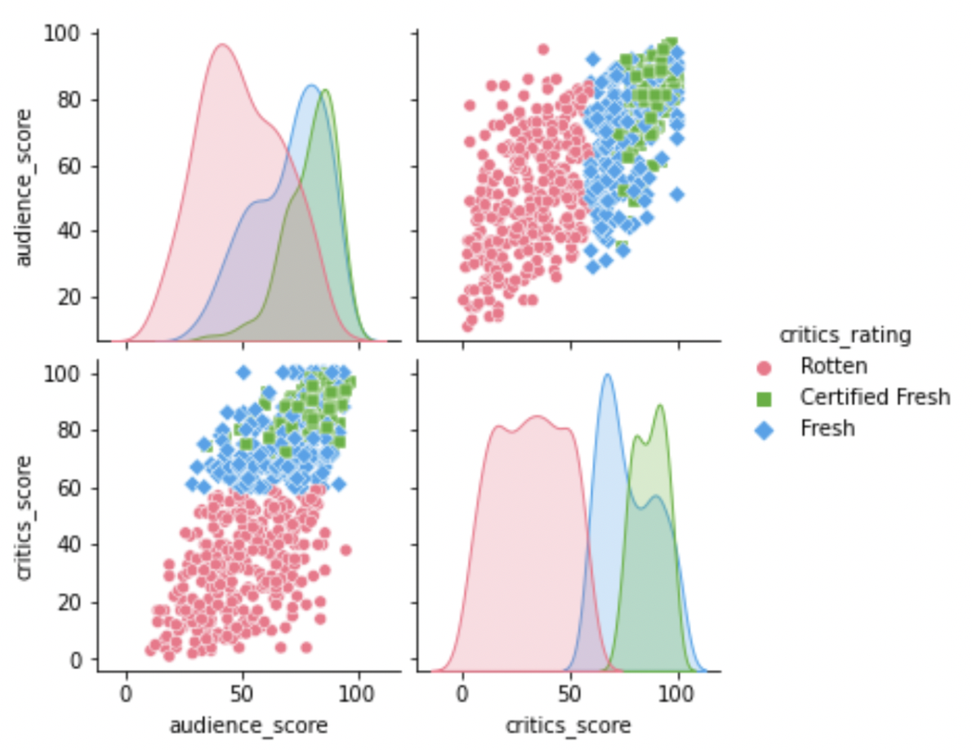
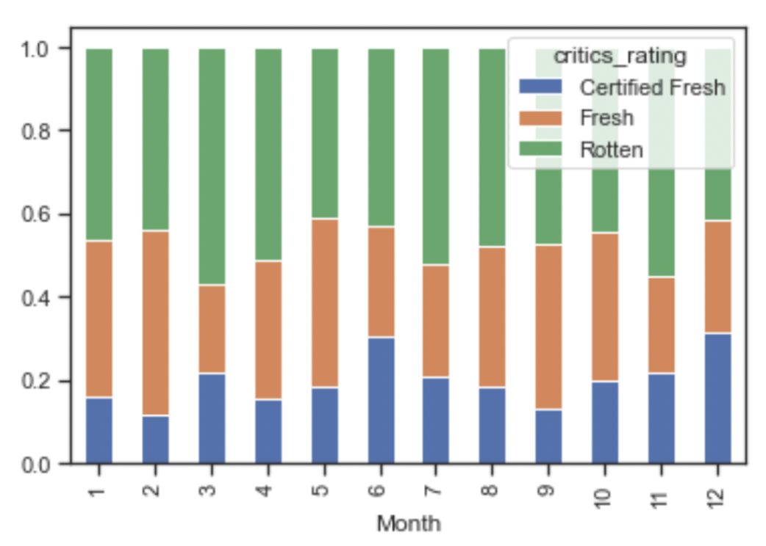
Data Exploration
Many interesting insights were made during the exploration phase, including the connection between audience score and critics score, as well as the idea of movie ‘dump months.’

Slide 5
Model Selection
Model 1 - Logistic Regression
Response: Critics’ rating - multilevel + categorical
Predictor(s): Runtime, month of theater release, and audience score
Prior(s): Weakly informative (i.e. Normal(0,1), Beta(1,1) most common)
Expected log pointwise predictive density (ELPD) via WAIC : -322.77
Model 2 - Logistic Regression
Response: Critics’ rating - binary
Predictor(s): Audience score
Prior(s): Normal(mu=0, sigma=1), critics Beta(1,1)
ELPD via WAIC: -321.06

Slide 6
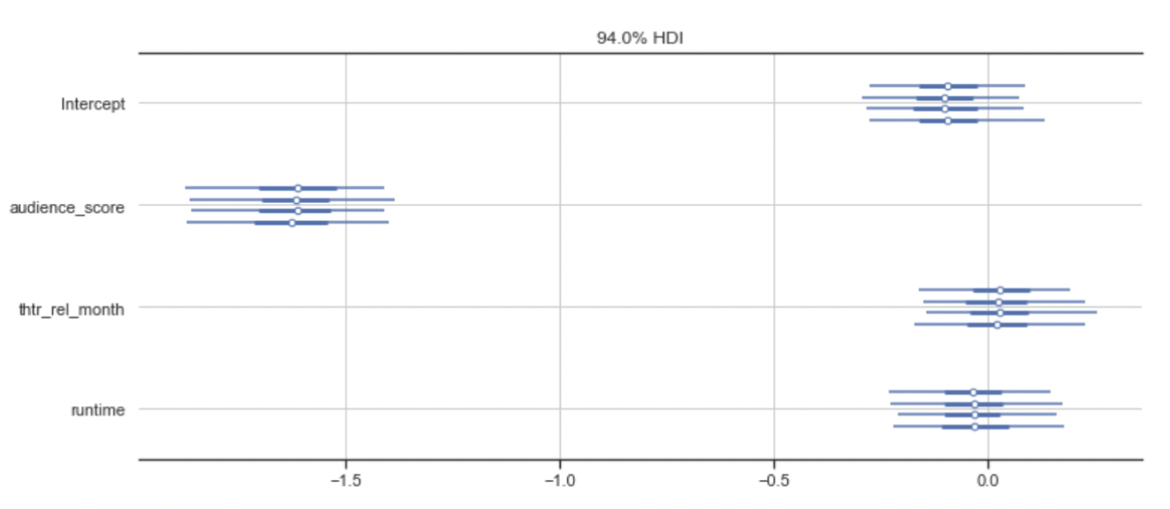
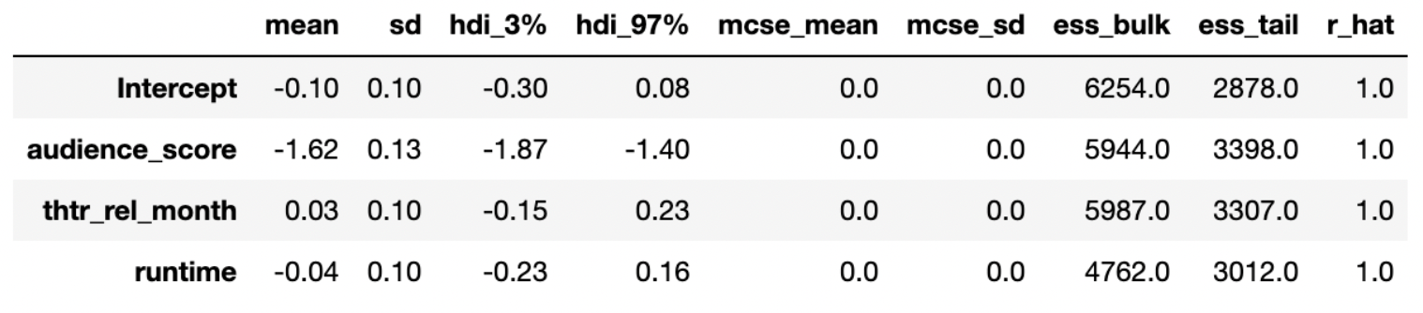
Bayesian Logistic Regression
A bayesian logistic regression was explored for the categorical variable critics_rating. Default priors were used, and the results showed audience_score as an effective predictor of critics_rating. However, the model had issues differentiating between Fresh and Certified Fresh.

Slide 7
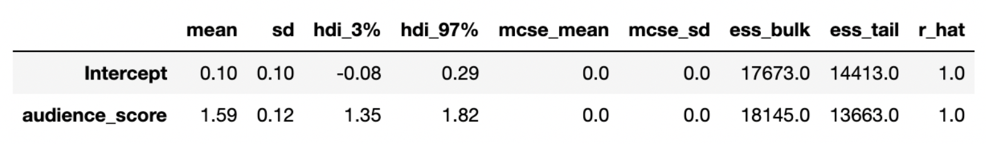
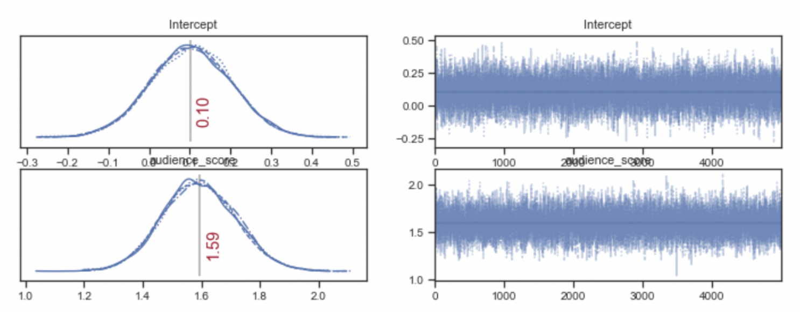
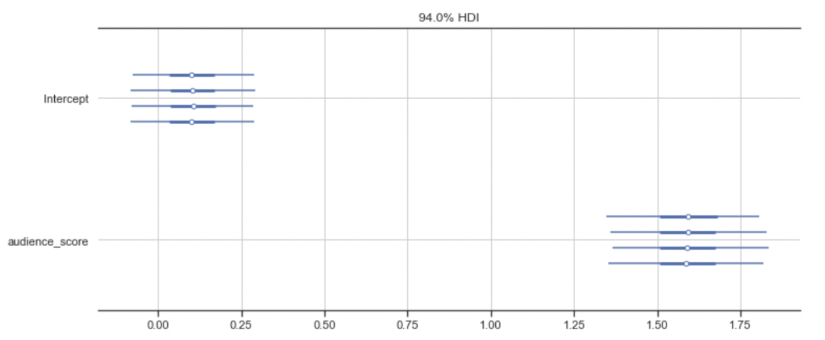
Bayesian Logistic Regression
After combining Fresh and Certified Fresh, a new logistic regression was explored using audience_score as a predictor and good_or_bad as the response.

Slide 8
Bayesian Additive Regression Trees
BART is a machine learning algorithm that applies Bayesian principles to an ensemble of decision trees
BART sets priors on tree depth, each tree’s contribution to the ensemble, and the standard deviation of the response variable
We utilized the default settings of the R library BART, which come from the original BART paper (Chipman et al, 2008)
We also simplified the response variable to a binary one (“Fresh” vs. “Not Fresh”) due to the requirements of the R library

Slide 9
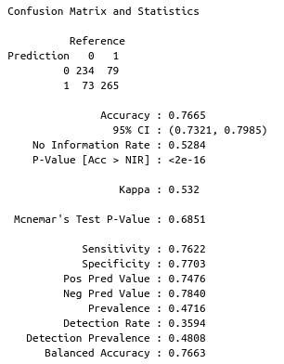
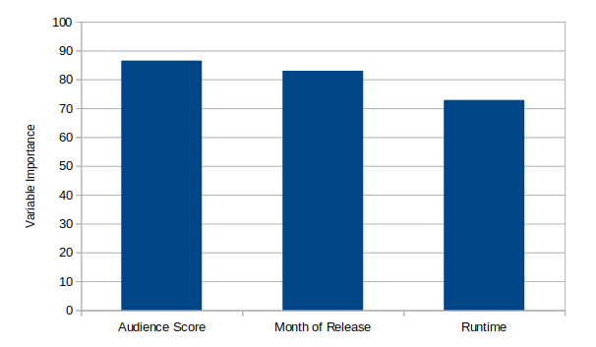
Bayesian Additive Regression Trees
Using the three independent variables (Audience Score, Month of Release and Runtime) we obtained a model with 76.7% accuracy
Variable importance (determined by mean decrease in Gini index) suggests all three variables contribute meaningfully

Slide 10
Summary
We explored many different variables related to the Tomatometer and created visualizations to discover trends within our data.
We used Bayesian statistics (via PyMC and BART) to determine important predictor variables for different logistic regressions.
We hope this research helps you make a decision effectively and efficiently next time you find yourself sifting through subscriptions!
Future extensions could bring in more outside data as predictors or develop a variety of models and apply Bayesian model averaging

